Slide 1
Approximate XML Query Answers
Neoklis Polyzotis (UC Santa Cruz)
Minos Garofalakis (Bell Labs)
Yannis Ioannidis (U. of Athens, Hellas)
Represented by: Gal Zach

Slide 2
Motivation
XML: de-facto standard for data exchange over the Internet.
Conflict between “on-line” and query execution cost
  Increased query response times
  Users might wait for un-interesting results
Processing the query over a concise synopsis of the XML data.
The approximate result should be:
  Computed fast
  Similar in its value content to the true result
  Similar in its hierarchical structure to the true result

Slide 3
Outline
Motivation
Background: Synopsis model
TreeSketch Synopses
Summarization model ⇔ Structural clustering of elements
Efficient processing and construction
Element Simulation Distance
Experimental Results

Slide 4
Twig Query - Example
for q1 in //a[//b]
for q2 in q1//p
return
q1//n,
for q3 in q2//k
return q3
q0
d
//a[//b]
q1
a
a
//p
//n
q2
q4
p
n
b
p
n
//k
q3
k
k
Twig query
Query tree
Nesting tree
The is for the paths that are specified in the return clause.

Slide 5
Synopsis Model
Let G =(VG,EG) a direct node-labeled graph.
A graph synopsis S(G)= (VS,ES) is a direct node-labeled graph where:
  Each Node v∈VS corresponds to a subset of element (or attribute) node in VG, termed the extent of v – extent(v), that have the same label.
  An edge (u,v)∈EG is represented in ES as an edge between nodes whose extent contains the two endpoints u and v.
Each synopsis node u store a tag tag(u) for the common tag of its element and a count field |u| for the size of its extent.

Slide 6
Synopsis Model
Synopsis node ➔ Set of elements of the same tag
Synopsis edge ➔ Document edge(s)
r
r
a1
a2
a3
a(3)
r
r
a1
a2
a3
a

Slide 7
Synopsis Model - Example
XML Data Graph
Synopsis graph
P0
P(1)
A(2)
PB(1)
A1
A2
PB3
N4
B5
P6
P7
N8
B9
N(2)
P(2)
B(2)
V4
F10
T11
T12
V8
F13
E14
T(2)
F(2)
E(1)
V10
V11
V12
V13
V14
Count(A) = | Extent(A) |
= | {A1,A2} | =2

Slide 8
Example for Twig-XSketch
r
r
R(1)
a1
a2
a1
a2
B/F
A(2)
b
b
b
b
b
b
b
b
B/F
B(4)
1 4 1 4
1 1 4 4
B/F
c
c
c
c
c
c
c
c
C(10)
Document T1
Document T2
Twig-XSketch
B/F=Backward forward
Note: The numbers on the edges represent how many edges are of this kind.

Slide 9
Count-Stability and the
TreeSketch Synopsis

Slide 10
Definitions
Let R ⊆ V x V denote an equivalence relation over the nodes of T(V,E), and let (u,v) denote a pair of equivalence classes (i.e. element node partition) induced by R.
The pair (u,v) is K-stable (K≥0) iff each element e∈u has exactly k child elements in v.
The relation R and the graph synopsis SR(T) resulting from the corresponding element partition are said to be count stable iff for every possible pair of element partitions (u,v) there exists some k≥0 such that (u,v) is k-stable.

Slide 11
Examples
r
r
r
r
a1
a2
a
a1
a2
a
b1
b2
b3
b
b1
b2
b3
b5
b6
b
b4
Tree T1
SR(T1)
Tree T2
SR(T2)
The pair (r, a) is 2-stable.
The pair (a, b) is not k-stable for any k≥0.
The pair (r, a) is 2-stable.
The pair (a, b) is 3-stable.
SR(T2) is count-stable.

Slide 12
Lemma
Given a data tree T(V,E) there exists a unique minimal (in terms of the number of equivalence classes) count-stable equivalence relation R⊆ V x V.
Furthermore, there exists a function Expand from stable relations to XML trees, such that Expand(R) is isomorphic to the original document tree T.

Slide 13
Example
r
r
r
r
a1
a2
a1
a2
2
1
1
b
b
b
b
a
b
b
b
b
a
a
1 4 1 4
1 1 4 4
1
1
2
2
c
c
c
c
b
b
c
c
c
c
b
b
1
1
4
4
c
c
SR(T1)
SR(T2)

Slide 14
TreeSketch Synopsis
TreeSketch synopsis TS for an XML data tree
T is a graph-synopsis for T where:
Each node u in TS stores an element count count(u) = |extent(u)|.
Each edge (u,v) in TS stores an (average) child count count(u,v) equal to the average number of children in extent(v) for each element in extent(u).

Slide 15
TreeSketch Synopsis
The interpretation of the stored average is simple:
All elements in the extent of u have count(u,v) child elements in the extent of v.

Slide 16
TreeSketches and Clustering

Slide 17
TreeSketches and Clustering
Let u be a synopsis node with outgoing edges
u v1,…,u vn. The set of outgoing edges defines a n-dimnetional space where an element e ∈ u is mapped to point (c1(e),…,cn(e)) if it has ci(e) children to node vi, 1≤ i ≤n.
The recorded average edge counts essentially map all points in this space to point (count(u,v1),…,count(u,vn)), which actually represents the centroid of the cluster.

Slide 18
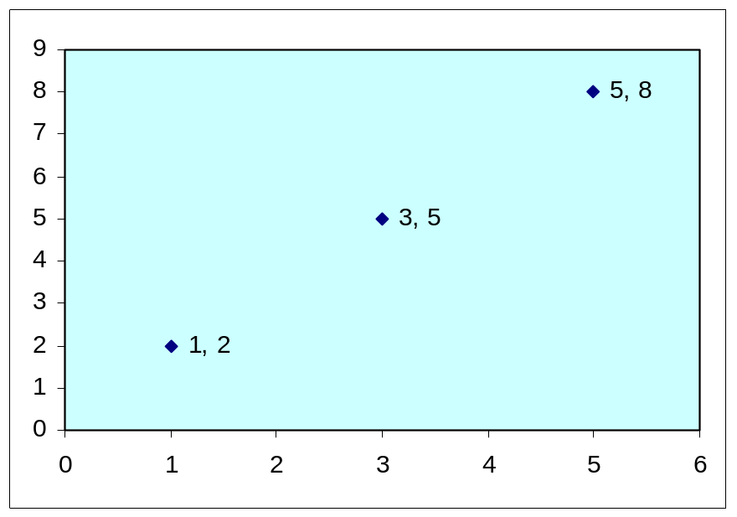
TreeSketches and Clustering - Example
r(1)
r
a1
a2
a(2)
1 2 5 8
3 5
b
c
b
c
b(6)
c(10)
Original tree
Synopsis tree
a1 (1,2)
a2 (5,8)
a (3,5)

Slide 19
TreeSketches and Clustering
We can characterize the quality of a TreeSketch synopsis by using a metric that quantifies the quality of the induced clustering.
The metric used in the article is the squared error of the clustering which essentially measures the euclidean distance between points and their corresponding centroid.
The squared error of a single cluster u is defined as sq(u) = Σe∈uΣ1≤ i ≤n(ci(e)-count(ui,vi))²
Sq(TS) for a synopsis TS is simply the sum of squared errors for all the induced clusters.

Slide 20
TreeSketches and Clustering
Note that the squared error for a count-stable synopsis is zero since all edge-count centroids are exact, i.e., the child count for any element in a given synopsis node extent are identical.
  Tight clusters ➔ Accurate synopsis
  The perfect synopsis corresponds to a perfect clustering

Slide 21
Building the Count-Stable Summery

Slide 22
BUILDSTABLE Algorithm
Input: XML document T.
Output: Count-Stable synopsis S to T.
Begin
H=Ф; S=Ф
foreach e∈T in post-order do
C={(ui,ci):ui is a node in S and ci=|children(e)∩extent(ui)|>0}
if (H[lable(e),C]=Ф) than
Add node u to S with label(u)=label(e)
H[lable(e),C]=u
for (ui,ci)∈C do add edge u ui to S
endif
u=H[lable(e),C]; extent(u)=extent(u)U{e}
endfor
end
=>The algorithm time: O(|T|)

Slide 23
Example
S
T
r
H
r
r’
1
1
(b, Ф) = b’
a1
a2
a1
a2
a’
a’’
(a,{(b’,2)}) = a’
2
1
(a, {(b’,1)}) = a’’
b3
b1
b3
b1
b2
b’
b2
(r,{(a’,1),(a’’,1)}) = r’
C= Ф
C= {(b’,2)}
C= Ф
C= {(b’,1)}
C= {(a’,1),(a’’,1)}

Slide 24
Space Budget Limitations
Given an XML tree T, build a TreeSketch of size B
Difficult clustering problem
  Space dimensionality depends on the clustering itself
Construction based on bottom-up clustering
  Compress perfect synopsis by merging clusters
  Best merge determined by marginal gains
…
Perfect
Space Budget

Slide 25
TSBUILD Algorithm
Maintain a pool of candidate operations for merging 2 nodes of TS in size Uh (given as input to the algorithm).
m(TS) denotes the resulting synopsis after applying merge m on TS.
m.errd = sq(m(TS)) - sq(TS) is the increase in squared error from TS to m(TS).
m.sized = size(TS) - size(m(TS)) is the decrease in synopsis size.
The operations pool is organized in min-heap according to the marginal-gain ratio m.errd / m.sized.

Slide 26
TSBUILD: Main Steps
Input:
    XML Tree T.
    Space budget S.
    Upper/Lower bounds for heap size (Uh, Lh).
Output: TreeSketch synopsis TS of T of size ≤ S.
Main Steps:
    TS = BuildStable(T);
    Creates the pool of candidates merge operations on size Uh.
    Applying each merge operation on it’s turn on TS.
    After each merge, recompute all necessary parameters of TS.
    If TS drops bellow size S, the algorithm stops.
    If the pool size drops below the bound Lh, replenish it.

Slide 27
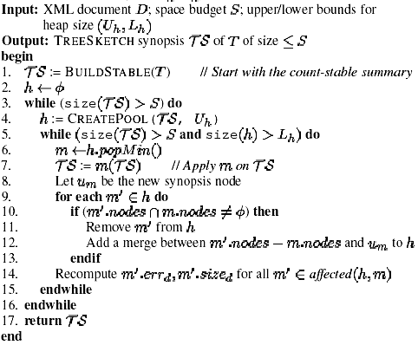
TSBUILD

Slide 28
CREATEPOOL Algorithm
Generate all possible pair-wise merges and keep the top Uh O(N²) merge operations.
Key observation: Two elements have similar structure, if their children have similar structure.
  Children clusters should be merged first.
Bottom-up merging, based on depth
  Depth: distance from the leaves of the tree.
  Build a pool of candidate merges by increasing depth.
  Replenish the pool when it falls below a given threshold.

Slide 29
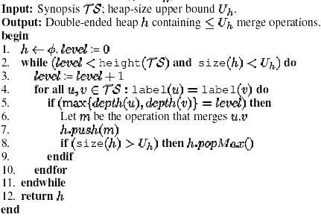
CREATEPOOL

Slide 30
Approximate Query Processing

Slide 31
EVALQUERY: Main Steps
Input:
    TreeSketch TS of document T.
    Twig Query Q.
Output: TreeSketch TQ that approximates the nesting tree NT(Q).
Main Steps:
    Go in pre-order traversal on Q.
    After qj was added, go to it’s son qi.
    Add the node qi∈Q if it doesn’t exists yet, and calculate the paths number from qj to it, acording to TS.
    Connect qi to qj (the parent node) by adding an edge.

Slide 32
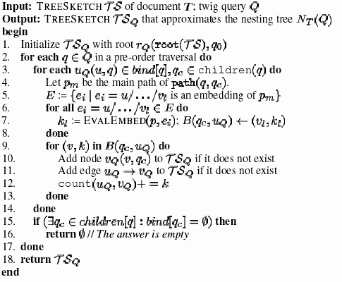
EVALQUERY Algorithm

Slide 33
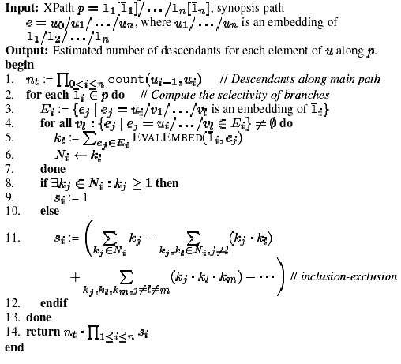
EVALEMBED

Slide 34
Example
q0
r
rQ (q0)
//a
10
10
q1
A
AQ(q1)
d[/g]//f
b|e
5
2
5
0.88
0.2
0.2
q3
q2
B
E
D
BQ(q2)
EQ(q2)
FQ(q3)
//f
2
5
0.7
5
0.5
0.6
2
q4
F
G1
G2
FQ(q4)
c
1.5
1.5
q5
C
CQ(q5)
Query
TREESKETCH
Result TREESKETCHTSQ

Slide 35
Example Cont.
Let us consider the processing of node q1 (on the query), and more specifically the computation of bindings from q1 to q3.
Starting from node A, which appears in the bindings of q1, we can identify exactly one simple embedding of path(q1,q3)=d[/g]//f, namely e=A/D/F. The bindings of q3, therefore, will be the descendants of A along the given embedding.
The number of descendants for each element in A:
nt = count(A,D)·count(D,F)=2·0.5=1.
s = 0.6+0.7-0.6·0.7=0.88.
=> The number descendants along d[/g]//f for each binding q1 is 1·0.88 = 0.88.

Slide 36
Error of Approximation - Abstract
The error of approximation is quantified by the distance between the 2 XML trees.
The distance represents how much 2 trees are similar, by the aspects of structure and meaning.
ESD - Element Simulation Distance - is a metric described on the article which quantifies the above-mentioned distance.

Slide 37
Experimental Study
Data Sets:
  IMDB - real-life data set from the Internet Movie Data Base.
  XMark - synthetic data set that models transactions on an online-action.
  SwissProt - real-life data set with annotations on proteins.
Workload: 1000 random twig queries.
Evaluation metrics:
  Average ESD for approximate answers

Slide 38
Data Sets Characteristics
Data sets | Elements | File size (MB) | Stable Synopsis Size (KB)
IMDB | 102,754 | 3 | 77
XMARK | 103,135 | 5 | 276
SProt | 182,300 | 4 | 265

Slide 39
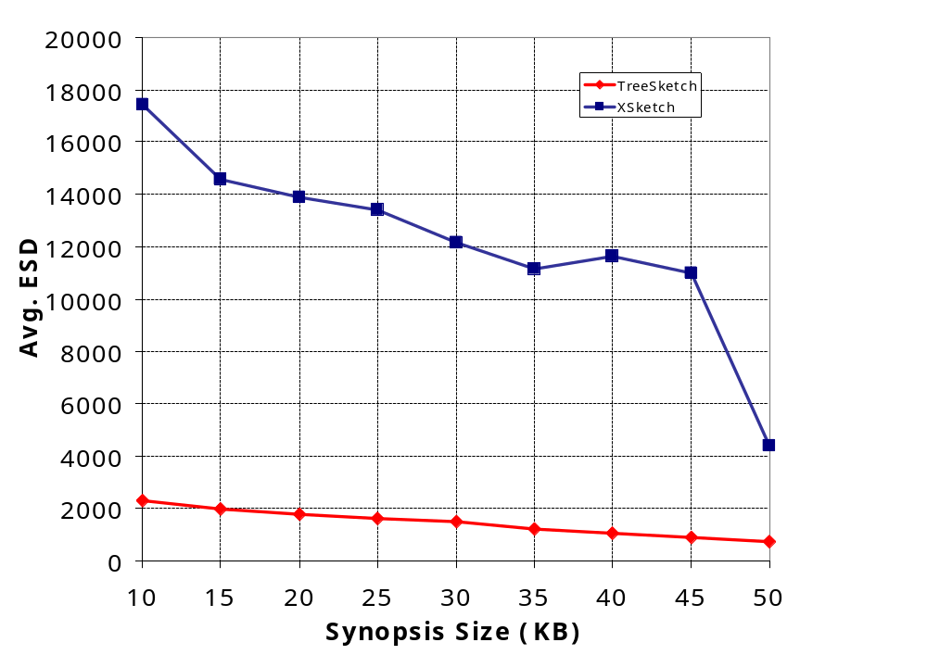
Approximate Answers
IMDB (~102K Elements)
Avg. Result Size: 3,477 tuples

Slide 40
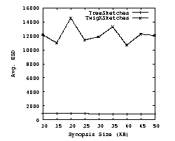
Approximate Answers
XMark (~103K Elements)
Avg. Result Size: 2,436 tuples
TreeSkethces
.
TwigXSkethces
Avg. ESD
Synopsis size (KB)

Slide 41
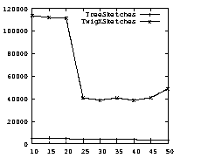
Approximate Answers
SwissPort (~182K Elements)
Avg. Result Size: 104,592 tuples
TreeSkethces
.
TwigXSkethces
Avg. ESD
Synopsis size (KB)

Slide 42
Construction times
Construction times (minutes) for TREESKETCHes and twig-XSKETCHes.
 | IMDB | XMark | Swiss-Port
TREESKETCHes | 0.7 | 8 | 10
Twig-XSKETCHes | 13 | 47 | 55

Slide 43
Error of Approximation
Let NTS(Q) be the approximate nesting tree that is computed over a concise synopsis TS, and let NT(Q) be the true nesting tree of the query Q.
The error of approximation is quantified by the distance between the 2 XML trees, denoted as distA(NTS(Q), NT(Q)).
We will use the tree-edit distance metric, which measure only the syntactic differences.

Slide 44
Tree-edit distance metric
The tree-edit distance distE(T1,T2) between 2 XML trees measures the minimum cost sequence of edit operations the transform T1 to T2.
Operations on tree nodes (basic):
Adding
Deleting
Relabeling

Slide 45
Tree-edit distance metric - Example
r
r
r
a
a
a
a
a
a
4 1 1 4
1 1 4 4
6 2 2 6
Sc
Sd
Sc
Sd
Sc
Sd
Sc
Sd
Sc
Sd
Sc
Sd
Query answer T
Approximation T1
Approximation T2
distE(T,T1) = 3·|Sc|+3·|Sc| = 3·|Sc|+3·|Sd| = distE(T,T2)

Slide 46
Element Simulation Distance
New distance metric for XML trees.
Considers both the overall path structure and the distribution of document edges.
Defined recursively.
Uses existing distance metric such as MAC (match and compare) and EMD (earth mover’s distance).
Note: these metrics are not described on the article.

Slide 47
Element Simulation Distance
MAC: A numerical measure to quantify the quality of an approximate answer to a set-valued query.
EMD: Measures a distance between 2 distributions, which reflects the minimal amount of work that must be performed to transform one distribution into the other by moving “distribution mass” around.

Slide 48
Element Simulation Distance
Let u∈T1 v∈T2 be elements of the compared trees where label(u)=label(v).
Let Ut, Vt denote the children sets of u, v respectively, that have tag t.
ESD(u’,v’) denotes the distance between any 2 elements u’∈Ut, v’∈Vt.
The distance distς(Ut, Vt) between Ut, Vt is defined by using an existing value set distance metric, like MAC or EMD.
ESD(u,v) = Σdistς(Ut, Vt)

Slide 49
Element Simulation Distance
Assume without loss of generality that Vt=Ø.
For each element e∈Ut, we insert a unique element ev in Vt with distance ESD(e,ev)=|e|, where |e| is the sub-trees size of e, and ESD(e’,ev)=∞, for all e’∈ Ut, e’≠e.
ESD Between two Trees :
ESD(T1,T2) = ESD(root(T1), root(T2)).

Slide 50
ESD - Example
Let u,v be the left a elements of T and T1 respectively. Element u,v have children of tags c and d and thus
ESD(u,v)= distς(Uc, Vc)+ distς(Ud, Vd).
ESD(ci,cj), ci∈Uc, cj∈Vc are equal to 0, since the elements have identical sub-trees. Notice that the 2 value sets contain equal values but at different multiplicities.
Using the MAC metric:
distς(Uc, Vc)=8 => ESD(u,v)=8+0=8.
r
r
a
a
a
a
4 1 1 4
1 1 4 4
Sc
Sd
Sc
Sd
Sc
Sd
Sc
Sd

Slide 51
ESD – Example Cont.
Let v’ be the left element a of T2. . . . ESD(u,v’)=6.
r
r
a
a
a
a
4 1 1 4
6 2 2 6
Sc
Sd
Sc
Sd
Sc
Sd
Sc
Sd

Slide 52
Questions

Slide 53
Thank You!

